Slide 1
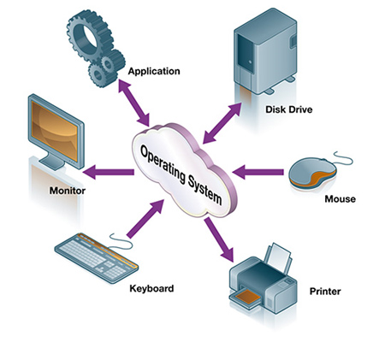
OPERATING SYSTEM

Slide 2
What is an Operating System
A program that acts as an intermediary between a user of a computer and the computer hardware.
Operating system goals:
Execute user programs and make solving user problems easier.
Make the computer system convenient to use.
Use the computer hardware in an efficient manner.

Slide 3
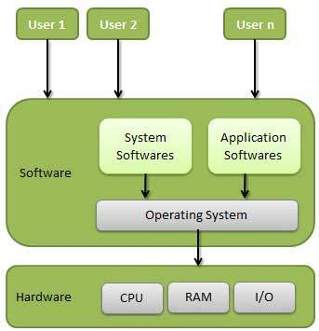

Slide 4
What is an Operating System
It is an extended machine
Hides the messy details which must be performed
Presents user with a virtual machine, easier to use
It is a resource manager
Each program gets time with the resource
Each program gets space on the resource

Slide 5
The operating system (OS) is the most important program that runs on a computer.
Operating systems perform basic tasks, such as recognizing input from the keyboard, sending output to the display screen, keeping track of files and directories on the disk, and controlling peripheral devices such as disk drives and printers.
Every general-purpose computer must have an operating system to run other programs and applications.
For large systems, the operating system has even greater responsibilities and powers. It is like a traffic cop -- it makes sure that different programs and users running at the same time do not interfere with each other.
The operating system is also responsible for security, ensuring that unauthorized users do not access the system.

Slide 6
Interacting With the Operating System
As a user, you normally interact with the operating system through a set of commands. For example, the DOS operating system contains commands such as COPY and RENAME for copying files and changing the names of files, respectively.
The commands are accepted and executed by a part of the operating system called the command processor or command line interpreter. Graphical user interfaces allow you to enter commands by pointing and clicking at objects that appear on the screen.

Slide 7
History of Operating Systems
First generation 1945 - 1955
vacuum tubes, plug boards
Second generation 1955 - 1965
transistors, batch systems
Third generation 1965 – 1980
ICs and multiprogramming
Fourth generation 1980 – present
personal computers

Slide 8
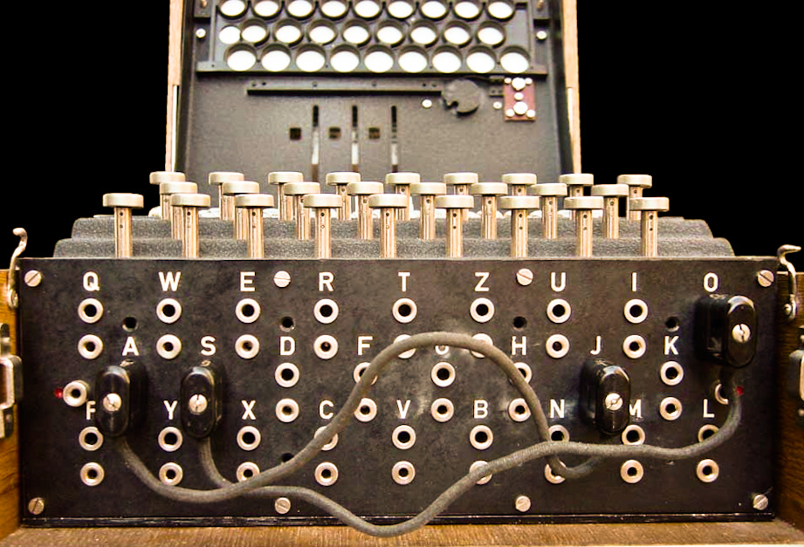
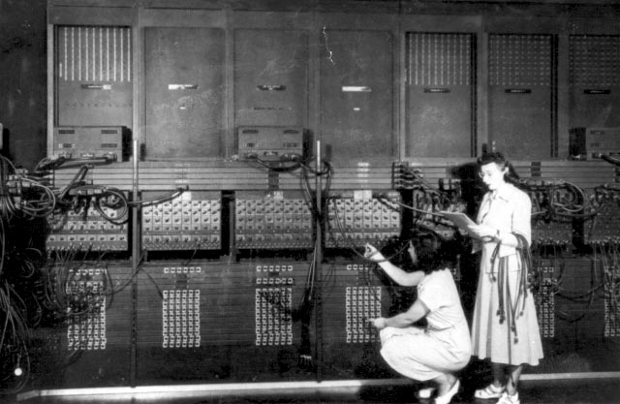
The First Generation (1945–55) Vacuum Tubes and Plugboards

Slide 9
The first ones used mechanical relays but were very slow, with cycle times measured in seconds. Relays were later replaced by vacuum tubes.
These machines were enormous, filling up entire rooms with tens of thousands of vacuum tubes, but they were still millions of times slower than even the cheapest personal computers available today.
In these early days, a single group of people designed, built, programmed, operated, and maintained each machine. All programming was done in absolute machine language, often by wiring up plugboards to control the machine's basic functions.

Slide 10
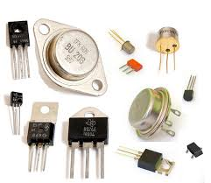
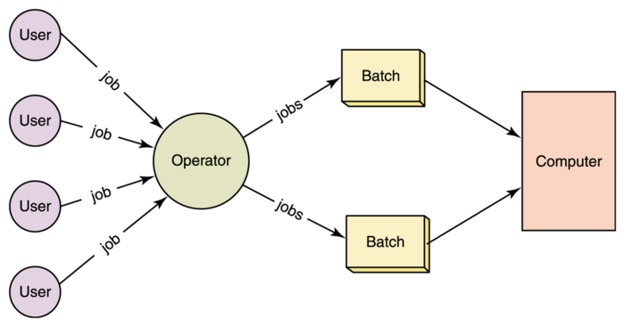
The Second Generation (1955–65) Transistors and Batch Systems

Slide 11
For the first time, there was a clear separation between designers, builders, operators, programmers, and maintenance personnel.
These machines, now called mainframes, were locked away in specially air conditioned computer rooms, with staffs of professional operators to run them. Only big corporations or major government agencies or universities could afford the multimillion dollar price tag. To run a job (i.e., a program or set of programs), a programmer would first write the program on paper (in FORTRAN or assembler), then punch it on cards. He would then bring the card deck down to the input room and hand it to one of the operators and go drink coffee until the output was ready.

Slide 12
History of Operating Systems
Early batch system
bring cards to 1401
read cards to tape
put tape on 7094 which does computing
put tape on 1401 which prints output

Slide 13
The Third Generation (1965-1980) ICs and Multiprogramming
the ability to have several programs in memory at once, each in its own memory partition, as shown in Fig.
While one job was waiting for I/O to complete, another job could be using the CPU. Special hardware kept one program from interfering with another.
Another major feature present in third-generation operating systems was the ability to read jobs from cards onto the disk as soon as they were brought to the computer room.
Then, whenever a running job finished, the operating system could load a new job from the disk into the now-empty partition and run it.
This technique is called spooling (from Simultaneous Peripheral Operation On Line) and was also used for output. With spooling, the 1401s were no longer needed, and much carrying of tapes disappeared.

Slide 14
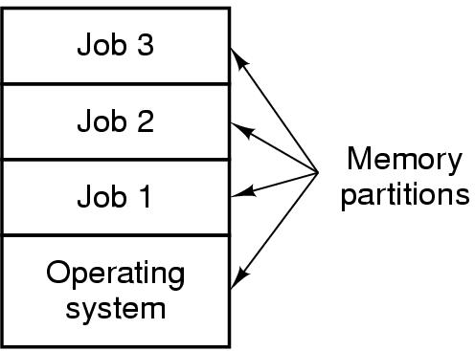
History of Operating Systems
Multiprogramming system
three jobs in memory – 3rd generation

Slide 15
The Fourth Generation (1980-Present) Personal Computers
With the development of LSI (Large Scale Integration) circuits, chips containing thousands of transistors on a square centimeter of silicon, the age of the personal computer dawned.
Where the minicomputer made it possible for a department in a company or university to have its own computer, the microprocessor chip made it possible for a single individual to have his or her own personal computer.
CP/M, MS-DOS, and other operating systems for early microcomputers were all based on users typing in commands from the keyboard. That eventually changed due to research done by Doug Engelbart at Stanford Research Institute in the 1960s.
Engelbart invented the GUI Graphical User Interface, complete with windows, icons, menus, and mouse.

Slide 16
Processors
The "brain" of the computer is the CPU. It fetches instructions from memory and executes them.
The basic cycle of every CPU is to fetch the first instruction from memory, decode it to determine its type and operands, execute it, and then fetch, decode, and execute subsequent instructions.
The cycle is repeated until the program finishes. In this way, programs are carried out.

Slide 17
CPU internals
Execute unit
Fetch unit
Decode unit
Fetch unit
Decode unit
Execute unit
Buffer
Execute unit
Fetch unit
Decode unit
Execute unit
Pipelined CPU
Superscalar CPU

Slide 18
Memory
The second major component in any computer is the memory.
Ideally, a memory should be extremely fast (faster than executing an instruction so the CPU is not held up by the memory), abundantly large.
No current technology satisfies all of these goals, so a different approach is taken.
The memory system is constructed as a hierarchy of layers, as shown in Fig.

Slide 19
Storage pyramid
Capacity
Access latency
< 1 KB
Registers
1 ns
Better
1 MB
Cache (SRAM)
2–5 ns
256 MB
Main memory (DRAM)
50 ns
40 GB
Magnetic disk
5 ms
Better
> 1 TB
Magnetic tape
50 sec
Goal: really large memory with very low latency
Latencies are smaller at the top of the hierarchy
Capacities are larger at the bottom of the hierarchy
Solution: move data between levels to create illusion of large memory with low latency

Slide 20
Disk drive structure
Data stored on surfaces
Up to two surfaces per platter
One or more platters per disk
Data in concentric tracks
Tracks broken into sectors
Cylinder: corresponding tracks on all surfaces
Data read and written by heads
Actuator moves heads
Heads move in unison
head
sector
platter
track
cylinder
surfaces
spindle
actuator

Slide 21
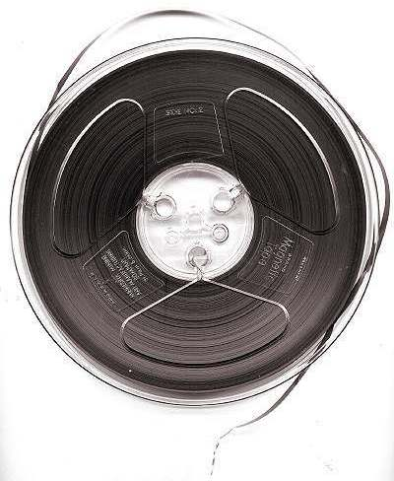
The final layer in the memory hierarchy is magnetic tape.
This medium is often used as a backup for disk storage and for holding very large data sets.
The big plus of tape is that it is exceedingly cheap per bit and removable, which is important for backup tapes that must be stored off-site in order to survive fires, floods, earthquakes, and other disasters.

Slide 22
I/O Devices
The CPU and memory are not the only resources that the operating system must manage. I/O devices also interact heavily with the operating system.
I/O devices generally consist of two parts: a controller and the device itself.
The controller is a chip or a set of chips that physically controls the device.
A device controller is a part of a computer system that makes sense of the signals going to, and coming from the CPU. There are many device controllers in a computer system. Any device connected to the computer is connected by a plug and socket, and the socket is connected to a device controller.
It accepts commands from the operating system, for example, to read data from the device, and carries them out
The other piece is the actual device itself. Devices have fairly simple interfaces

Slide 24
I/O Devices
Input and output can be done in three different ways.
In the simplest method, a user program issues a system call, which the kernel then translates into a procedure call to the appropriate driver.
The driver then starts the I/O and sits in a tight loop continuously polling the device to see if it is done (usually there is some bit that indicates that the device is still busy).
When the I/O has completed, the driver puts the data (if any) where they are needed and returns.
The operating system then returns control to the caller.
This method is called busy waiting and has the disadvantage of tying up the CPU polling the device until it is finished.

Slide 25
I/O Devices
The second method is for the driver to start the device and ask the device to give an interrupt when it is finished.
When the controller detects the end of the transfer, it generates an interrupt to signal completion.
Interrupts are very important in operating systems, so let us examine the idea more closely. In Fig. 1-11(a) we see a three-step process for I/O.
In step 1, the driver tells the controller what to do by writing into its device registers.
The controller then starts the device.
When the controller has finished reading or writing the number of bytes it has been told to transfer, it signals the interrupt controller chip using certain bus lines in step 2.
If the interrupt controller is prepared to accept the interrupt (which it may not be if it is busy with a higher-priority one), it asserts a pin on the CPU chip informing it, in step 3.
In step 4, the interrupt controller puts the number of the device on the bus so the CPU can read it and know which device has just finished (many devices may be running at the same time).

Slide 27
BUSES
A collection of wires through which data is transmitted from one part of a computer to another.
You can think of a bus as a highway on which data travels within a computer.
When used in reference to personal computers, the term bus usually refers to internal bus.
This is a bus that connects all the internal computer components to the CPU and main memory.
As processors and memories got faster, the ability of a single bus to handle all the traffic was strained to the breaking point.
As a result, additional buses were added, both for faster I/O devices and for CPU-to-memory traffic.

Slide 29
This system has eight buses (cache, local, memory, PCI, SCSI, USB, IDE,and ISA), each with a different transfer rate and function.
The operating system must be aware of all of them for configuration and management.
The two main buses are the original IBM PC ISA (Industry Standard Architecture) bus and its successor, the PCI (Peripheral Component Interconnect) bus.
In addition, this system contains three specialized buses: IDE, USB, and SCSI.
The IDE bus is for attaching peripheral devices such as disks and CDROMs to the system. The IDE bus is an outgrowth of the disk controller interface.
The USB (Universal Serial Bus) was invented to attach all the slow I/O devices, such as the keyboard and mouse, to the computer.
All the USB devices share a single USB device driver, making it unnecessary to install a new driver for each new USB device.
Consequently, USB devices can be added to the computer without the need to reboot.
The SCSI (Small Computer System Interface) bus is a high-performance bus intended for fast disks, scanners, and other devices needing considerable bandwidth.

Slide 30
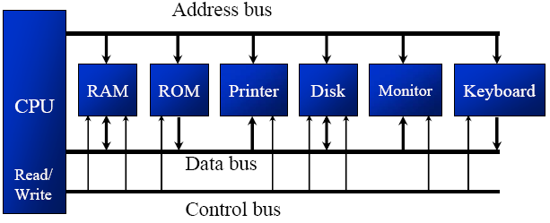

Slide 31
Booting the Computer
On the parentboard is a program called the system BIOS (Basic Input Output System).
The process of bringing up the operating system is called booting.Your computer knows how to boot because instructions for booting are built into one of its chips, the BIOS (or Basic Input/Output System) chip.
The BIOS chip tells it to look in a fixed place, usually on the lowest-numbered hard disk (the boot disk) for a special program called a boot loader .The boot loader is pulled into memory and started. The boot loader's job is to start the real operating system.
The BIOS contains low-level I/O software, including procedures to read the keyboard, write to the screen, and do disk I/O, among other things.
When the computer is booted, the BIOS is started. It first checks to see how much RAM is installed and whether the keyboard and other basic devices are installed and responding correctly.(POST- Post On Self Test)
It starts out by scanning the ISA and PCI buses to detect all the devices attached to them.
If the devices present are different from when the system was last booted, the new devices are configured.

Slide 32
Booting the Computer
The operating system then queries the BIOS to get the configuration information.
For each device, it checks to see if it has the device driver.
If not, it asks the user to insert a CD-ROM containing the driver (supplied by the device's manufacturer).
Once it has all the device drivers, the operating system loads them into the kernel.
Then it initializes its tables, creates whatever background processes are needed, and starts up a login program or GUI.

Slide 33
OPERATING SYSTEM CONCEPTS
Processes
Address Spaces
Files
Input/Output
Protection
The Shell

Slide 34
Processes
A key concept in all operating systems is the process. A process is basically a program in execution.
Associated with each process is its address space, a list of memory locations from 0 to some maximum, which the process can read and write.
The address space contains a executable program & the program's data.
Also associated with each process is a set of resources, commonly including registers (including the program counter and stack pointer), a list of open files, lists of related processes, and all the other information needed to run the program.
A process is fundamentally a container that holds all the information needed to run a program.

Slide 35
Processes
The user may have installed a video editing program and instructed it to convert a one-hour video to a certain format(something that can take hours) and then gone off to surf the Web.
Meanwhile, a background process that wakes up periodically to check for incoming e-mail may have started running.
Thus we have (at least) three active processes: the video editor, the Web browser, and the e-mail receiver.

Slide 36
Processes
If a process can create one or more other processes (referred to as child processes) and these processes in turn can create child processes, we quickly arrive at the process tree structure of
Related processes that are cooperating to get some job done often need to communicate with one another and synchronize their activities. This communication is called interprocess communication

Slide 37
A process tree.
Process A created two child processes, B and C.
Process B created three child processes, D, E, and F.

Slide 38
Processes
A process that is communicating with another process on a different computer does so by sending messages to the remote process over a computer network.
To guard against the possibility that a message or its reply is lost, the sender may request that its own operating system notify it after a specified number of seconds, so that it can retransmit the message if no acknowledgement has been received yet.
After setting this timer, the program may continue doing other work.

Slide 39
Address Spaces(memory management)
Every computer has some main memory that it uses to hold executing programs.
In a very simple operating system, only one program at a time is in memory.
To run a second program, the first one has to be removed and the second one placed in memory.
More sophisticated operating systems allow multiple programs to be in memory at the same time.
To keep them from interfering with one another (and with the operating system), some kind of protection mechanism is needed.
While this mechanism has to be in the hardware, it is controlled by the operating system.
The above viewpoint is concerned with managing and protecting the computer's main memory.

Slide 40
A different, but equally important memory-related issue, is managing the address space of the processes.
Normally, each process has some set of addresses it can use, typically running from 0 up to some maximum.
In the simplest case, the maximum amount of address space a process has is less than the main memory.
What happens if a process has more address space than the computer has main memory and the process wants to use it all?
Nowadays, a technique called virtual memory exists, in which the operating system keeps part of the address space in main memory and part on disk and shuttles pieces back and forth between them as needed.

Slide 41
Files
Another key concept supported by virtually all operating systems is the file system.
A major function of the operating system is to hide the peculiarities of the disks and other I/O devices and present the programmer with a nice, clean abstract model of device-independent files.
System calls are needed to create files, remove files, read files, and write files.
Before a file can be read, it must be located on the disk and opened, and after it has been read it should be closed, so calls are provided to do these things.
To provide a place to keep files, most operating systems have the concept of a directory as a way of grouping files together. A student, for example, might have one directory for each course he or she is taking, another directory for his electronic mail, and still another directory for his World Wide Web home page.
System calls are then needed to create and remove directories.
Calls are also provided to put an existing file in a directory, and to remove a file from a directory. Directory entries may be either files or other directories

Slide 42
This model also gives rise to a hierarchy—the file system—as shown in Fig.

Slide 43
Files
Before a file can be read or written, it must be opened, at which time the permissions are checked.
If the access is permitted, the system returns a small integer called a file descriptor to use in subsequent operations.
If the access is prohibited, error code is returned.
Another important concept in UNIX is the mounted file system. Nearly all personal computers have one or more optical drives into which CD-ROMs and DVDs can be inserted.
They almost always have USB ports, into which USB memory sticks (really, solid state disk drives) can be plugged, and some computers have floppy disks or external hard disks.
To provide an elegant way to deal with these removable media UNIX allows the file system on a CD-ROM or DVD to be attached to the main tree.
Consider the situation of Fig. Before the mount call, the root file system, on the hard disk, and a second file system, on a CDROM, are separate and unrelated.

Slide 45
Files
the file system on the CD-ROM cannot be used, because there is no way to specify path names on it.
UNIX does not allow path names to be prefixed by a drive name or number.
the mount system call allows the file system on the CD-ROM to be attached to the root file system wherever the program wants it to be.
In Fig. the file system on the CD-ROM has been mounted on directory b, thus allowing access to files fb/x and /b/y.
If directory b had contained any files they would not be accessible while the CD-ROM was mounted, since /b would refer to the root directory of the CD-ROM.

Slide 46
Files
The last feature we will discuss in this overview is one that relates to both processes and files: pipes.
A pipe can be used to connect two processes, as shown in Fig.
If processes A and B wish to talk using a pipe, they must set it up in advance.
When process A wants to send data to process B, it writes on the pipe as though it were an output file.
Process B can read the data by reading from the pipe as though it were an input file.
Thus, communication between processes in UNIX looks very much like ordinary file reads and writes.

Slide 48
Input/Output
All computers have physical devices for acquiring input and producing output.
Many kinds of input and output devices exist, including keyboards, monitors, printers, and so on.
It is up to the operating system to manage these devices.
Consequently, every operating system has an I/O subsystem for managing its I/O devices.

Slide 49
Protection
Computers contain large amounts of information that users often want to protect and keep confidential.
This information may include e-mail, business plans, tax returns, and much more.
It is up to the operating system to manage the system security so that files, for example, are only accessible to authorized users.
For e.g., Files in UNIX are protected by assigning each one a 9-bit binary protection code.
The protection code consists of three 3-bit fields, one for the owner, one for other members of the owner's group (users are divided into groups by the system administrator), and one for everyone else.

Slide 50
Protection
Each field has a bit for read access, a bit for write access, and a bit for execute access.
These 3 bits are known as the rwx bits.
For example, the protection code rwxr-x-x means that the owner can read, write, or execute the file, other group members can read or execute (but not write) the file, and everyone else can execute (but not read or write) the file.
For a directory, x indicates search permission. A dash means that the corresponding permission is absent.

Slide 51
The Shell
the UNIX command interpreter, called the shell.
It is also the primary interface between a user sitting at his terminal and the operating system, unless the user is using a graphical user interface.
When any user logs in, a shell is started up.
The shell has the terminal as standard input and standard output.
It starts out by typing the prompt, a character such as a dollar sign, which tells the user that the shell is waiting to accept a command.
If the user now types: date
for example, the shell creates a child process and runs the date program as the child.
While the child process is running, the shell waits for it to terminate.
When the child finishes, the shell types the prompt again and tries to read the next input line.

Slide 52
SYSTEM CALLS
Any single-CPU computer can execute only one instruction at a time.
If a process is running a user program in user mode and needs a system service, such as reading data from a file, it has to execute a trap instruction to transfer control to the operating system.
The operating system then figures out what the calling process wants by inspecting the parameters.
Then it carries out the system call and returns control to the instruction following the system call.

Slide 53
SYSTEM CALLS
operating systems have two main functions: providing abstractions to user programs and managing the computer's resources.
For the most part, the interaction between user programs and the operating system deals with the former; for example, creating, writing, reading, and deleting files.
The resource management part is largely transparent to the users and done automatically.
Thus the interface between user programs and the operating system is primarily about dealing with the abstractions.

Slide 54
Buffer
A temporary storage area, usually in RAM. The purpose of most buffers is to act as a holding area, enabling the CPU to manipulate data before transferring it to a device.
When a command is issued to print a document, the operating system copies the document to a printer buffer from which the printer can use it at its own pace. This frees the computer to perform other tasks while the printer is running in the background.
For example, word processors employ a buffer to keep track of changes to files. Then when you save the file, the word processor updates the disk file with the contents of the buffer. This is much more efficient than accessing the file on the disk each time you make a change to the file.

Slide 55
SYSTEM CALLS
In a read system call, it has three parameters: the first one specifying the file, the second one pointing to the buffer, and the third one giving the number of bytes to read.
count = read(fd, buffer, nbytes);
The system call return the number of bytes actually read in count.
If the system call cannot be carried out, either due to an invalid parameter or a disk error, count is set to —1.

Slide 56
SYSTEM CALLS
System calls are performed in a series of steps.
In preparation for calling the read library procedure, which actually makes the read system call, the calling program first pushes the parameters onto the stack, as shown in steps 1-3 in Fig.
The first and third parameters are called by value, but the second parameter is passed by reference, meaning that the address of the buffer (indicated by &) is passed, not the contents of the buffer.
Then comes the actual call to the library procedure (step 4). This instruction is the normal procedure call instruction used to call all procedures.

Slide 58
SYSTEM CALLS
The library procedure typically puts the system call number in a place where the operating system expects it, such as a register (step 5).
Then it executes a TRAP instruction to switch from user mode to kernel mode and start execution within the kernel (step 6).
The kernel code that starts following the TRAP examines the system call number and then dispatches to the correct system call handler (step7).
At that point the system call handler runs (step 8). Once the system call handler has completed its work, control may be returned to the user-space library procedure at the instruction following the TRAP instruction (step 9). This procedure then returns to the user program in the usual way procedure calls return (step 10).
To finish the job, the user program has to clean up the stack, as it does after any procedure call (step 11).

Slide 63
OPERATING SYSTEM STRUCTURE
Monolithic Systems
in this approach the entire operating system runs as a single program in kernel mode.
The operating system is written as a collection of procedures, linked together into a single large executable binary program.
When this technique is used, each procedure in the system is free to call any other one, if the latter provides some useful computation that the former needs.
Having thousands of procedures that can call each other without restriction often leads to an unwieldy and difficult to understand system.

Slide 64
OPERATING SYSTEM STRUCTURE
The operating system then fetches the parameters and determines which system call is to be carried out.
This organization suggests a basic structure for the operating system:
1. A main program that invokes the requested service procedure.
2. A set of service procedures that carry out the system calls.
3. A set of utility procedures that help the service procedures.

Slide 65
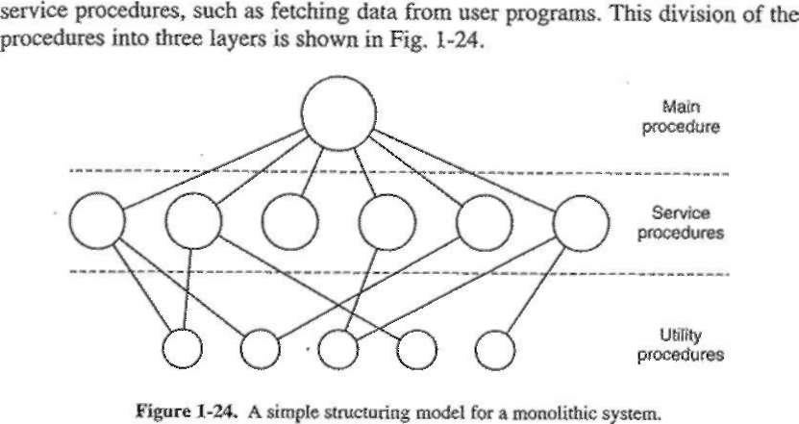
OPERATING SYSTEM STRUCTURE
In this model, for each system call there is one service procedure that takes care of it and executes it.
The utility procedures do things that are needed by several

Slide 66
OPERATING SYSTEM STRUCTURE
Layered Systems:
A generalization of the approach of Fig. is to organize the operating system as a hierarchy of layers, each one constructed upon the one below it.
The first system constructed in this way was the THE system built at the Technische Hogeschool Eindhoven in the Netherlands by E. W. Dijkstra (1968) and his students.
The system had six layers, as shown in Fig. 1-25. Layer 0 dealt with allocation of the processor, switching between processes when interrupts occurred or timers expired.
Above layer 0, the system consisted of sequential processes, each of which could be programmed without having to worry about the fact that multiple processes were running on a single processor.
In other words, layer 0 provided the basic multiprogramming of the CPU.

Slide 68
2.1.1 The Process Model
In this model, all the runnable software on the computer, sometimes including the operating system, is organized into a number of sequential processes.
A process is just an instance of an executing program, including the current values of the program counter, registers, and variables.
Conceptually, each process has its own virtual CPU.
In reality, of course, the real CPU switches back and forth from process to process. This rapid switching back and forth is called multiprogramming

Slide 70
In Fig. 2-1(a) we see a computer multiprogramming four programs in memory.
In Fig. 2-1(b) we see four processes, each with its own flow of control (i.e., its own logical program counter), and each one running independently of the other ones.
Of course, there is only one physical program counter, so when each process runs, its logical program counter is loaded into the real program counter.
When it is finished (for the time being), the physical program counter is saved in the process' stored logical program counter in memory.
In Fig. 2-1(c) we see that viewed over a long enough time interval, all the processes have made progress, but at any given instant only one process is actually running.

Slide 71
2.1.2 Process Creation
There are four principal events that cause processes to be created:
1. System initialization.
2. Execution of a process creation system call by a running process.
3. A user request to create a new process.
4. Initiation of a batch job.

Slide 72
When an operating system is booted, typically several processes are created.
Some of these are foreground processes, that is, processes that interact with (human) users and perform work for them.
Others are background processes, which are not associated with particular users, but instead have some specific function.
For example, one background process may be designed to accept incoming e-mail, sleeping most of the day but suddenly springing to life when incoming e-mail arrives.
Another background process may be designed to accept incoming requests for Web pages hosted on that machine, waking up when a request arrives to service the request.
Processes that stay in the background to handle some activity such as e-mail, Web pages, news, printing, and so on are called daemons.
Large systems commonly have dozens of them.

Slide 73
In addition to the processes created at boot time, new processes can be created afterward as well.
Often a running process will issue system calls to create one or more new processes to help it do its job.
For example, if a large amount of data is being fetched over a network for subsequent processing, it may be convenient to create one process to fetch the data and put them in a shared buffer while a second process removes the data items and processes them.
In interactive systems, users can start a program by typing a command or (double) clicking an icon.
Taking either of these actions starts a new process and runs the selected program in it.
In command-based UNIX systems running X, the new process takes over the window in which it was started.
In Microsoft Windows, when a process is started it does not have a window, but it can create one (or more) and most do.
In both systems, users may have multiple windows open at once, each running some process.
Using the mouse, the user can select a window and interact with the process, for example, providing input when needed.

Slide 74
In UNIX, there is only one system call to create a new process: fork.
This call creates an exact clone of the calling process.
After the fork, the two processes, the parent and the child, have the same memory image, the same environment strings, and the same open files.
Usually, the child process then executes execve or a similar system call to change its memory image and run a new program.
For example, when a user types a command, say, sort, to the shell, the shell forks off a child process and the child executes sort.

Slide 75
The last situation in which processes are created applies only to the batch systems found on large mainframes.
Here users can submit batch jobs to the system.
When the operating system decides that it has the resources to run another job, it creates a new process and runs the next job from the input queue in it.
Technically, in all these cases, a new process is created by having an existing process execute a process creation system call.
That process may be a running user process, a system process invoked from the keyboard or mouse, or a batch manager process.
What that process does is execute a system call to create the new process.
This system call tells the operating system to create a new process and indicates, directly or indirectly, which program to run in it.

Slide 76
In Windows, in contrast, a single Win32 function call, CreateProcess, handles both process creation and loading the correct program into the new process.
In both UNIX and Windows, after a process is created, the parent and child have their own distinct address spaces.
If either process changes a word in its address space, the change is not visible to the other process.

Slide 77
2.1.3 Process Termination
After a process has been created, it starts running and does whatever its job is.
However, nothing lasts forever, not even processes. Sooner or later the new process will terminate, usually due to one of the following conditions:
1. Normal exit (voluntary).
2. Error exit (voluntary).
3. Fatal error (involuntary).
4. Killed by another process (involuntary).

Slide 78
Most processes terminate because they have done their work.
When a compiler has compiled the program given to it, the compiler executes a system call to tell the operating system that it is finished.
This call is exit in UNIX and ExitProcess in Windows.
The second reason for termination is that the process discovers a fatal error.
For example, if a user types the command
cc foo.c
to compile the program foo.c and no such file exists, the compiler simply exits.
Screen-oriented interactive processes generally do not exit when given bad parameters. Instead they pop up a dialog box and ask the user to try again.

Slide 79
The third reason for termination is an error caused by the process, often due to a program bug.
Examples include executing an illegal instruction, referencing nonexistent memory, or dividing by zero.
In some systems (e.g., UNIX), a process can tell the operating system that it wishes to handle certain errors itself, in which case the process is signaled (interrupted) instead of terminated when one of the errors occurs.
The fourth reason a process might terminate is that the process executes a system call telling the operating system to kill some other process.
In UNIX this call is kill. The corresponding Win32 function is TerminateProcess. In both cases, the killer must have the necessary authorization to do in the killee.

Slide 80
2.1.4 Process Hierarchies
In some systems, when a process creates another process, the parent process and child process continue to be associated in certain ways.
The child process can itself create more processes, forming a process hierarchy.
a process has only one parent (but zero, one, two, or more children).
In UNIX, a process and all of its children and further descendants together form a process group.
When a user sends a signal from the keyboard, the signal is delivered to all members of the process group currently associated with the keyboard.
Individually, each process can catch the signal, ignore the signal, or take the default action, which is to be killed by the signal.

Slide 81
As another example of where the process hierarchy plays a key role, let us look at how UNIX initializes itself when it is started, just after the computer is booted.
A special process, called init, is present in the boot image.
When it starts running, it reads a file telling how many terminals there are.
Then it forks off a new process per terminal. These processes wait for someone to log in.
If a login is successful, the login process executes a shell to accept commands.
These commands may start up more processes, and so forth.
Thus, all the processes in the whole system belong to a single tree, with init at the root.

Slide 82
2.1.5 Process States
Although each process is an independent entity, with its own program counter and internal state, processes often need to interact with other processes.
One process may generate some output that another process uses as input.
In the shell command
cat chapter1 chapter2 chapter3 | grep tree
the first process, running cat, concatenates and outputs three files.
The second process, running grep, selects all lines containing the word ‘‘tree.’’
Depending on the relative speeds of the two processes it may happen that grep is ready to run, but there is no input waiting for it.
It must then block until some input is available.
When a process blocks, it does so because logically it cannot continue, because it is waiting for input that is not yet available.
It is also possible for a process that is ready and able to run to be stopped because the operating system has decided to allocate the CPU to another process for a while.

Slide 83
In Fig. 2-2 we see a state diagram showing the three states a process may be in:
1. Running (actually using the CPU at that instant).
2. Ready (runnable; temporarily stopped to let another process run).
3. Blocked (unable to run until some external event happens).
Logically, the first two states are similar.
In both cases the process is willing to run, only in the second one, there is temporarily no CPU available for it.
The third state is fundamentally different from the first two in that the process cannot run, even if the CPU is idle and has nothing else to do.

Slide 85
Four transitions are possible among these three states, as shown.
Transition 1 occurs when the operating system discovers that a process cannot continue right now.
In UNIX, when a process reads from a pipe or special file (e.g., a terminal) and there is no input available, the process is automatically blocked.
Transitions 2 and 3 are caused by the process scheduler, a part of the operating system, without the process even knowing about them.
Transition 2 occurs when the scheduler decides that the running process has run long enough, and it is time to let another process have some CPU time.
Transition 3 occurs when all the other processes have had their fair share and it is time for the first process to get the CPU to run again.

Slide 86
Transition 4 occurs when the external event for which a process was waiting (such as the arrival of some input) happens.
If no other process is running at that instant, transition 3 will be triggered and the process will start running.
Otherwise it may have to wait in ready state for a little while until the CPU is available and its turn comes.
In the model shown in Fig. 2-3, the lowest level of the operating system is the scheduler, with a variety of processes on top of it.
All the interrupt handling and details of actually starting and stopping processes are hidden away in what is here called the scheduler.

Slide 88
2.1.6 Implementation of Processes
To implement the process model, the operating system maintains a table called the process table, with one entry per process.
This entry contains important information about the process’ state, including its program counter, stack pointer, memory allocation, the status of its open files and everything else about the process that must be saved when the process is switched from running to ready or blocked state so that it can be restarted later as if it had never been stopped.
A process may be interrupted thousands of times during its execution, but the key idea is that after each interrupt the interrupted process returns to precisely the same state it was in before the interrupt occurred.

Slide 89
2.2 THREADS
A thread is the smallest unit of processing that can be performed in an OS. In most modern operating systems, a thread exists within a process - that is, a single process may contain multiple threads.
You can imagine multitasking as something that allows processes to run concurrently, while multithreading allows sub-processes to run concurrently.
When multiple threads are running concurrently, this is known as multithreading, which is similar to multitasking.
Basically, an operating system with multitasking capabilities allows programs (or processes) to run seemingly at the same time. On the other hand, a single program with multithreading capabilities allows individual sub-processes (or threads) to run seemingly at the same time.
One example of multithreading is downloading a video while playing it at the same time.

Slide 90
2.2.1 Thread Usage
The main reason for having threads is that in many applications, multiple activities are going on at once.
As a first example, consider a word processor. Word processors usually display the document being created on the screen formatted exactly as it will appear on the printed page.
Suppose that the user is writing a book.
From the author’s point of view, it is easiest to keep the entire book as a single file to make it easier to search for topics, perform global substitutions, and so on.
Alternatively, each chapter might be a separate file.
However, having every section and subsection as a separate file is a real nuisance when global changes have to be made to the entire book, since then hundreds of files have to be individually edited, one at a time.
For example, if proposed standard xxxx is approved just before the book goes to press, all occurrences of ‘‘Draft Standard xxxx’’ have to be changed to ‘‘Standard xxxx’’ at the last minute.
If the entire book is one file, typically a single command can do all the substitutions.
In contrast, if the book is spread over 300 files, each one must be edited separately.

Slide 91
Now consider what happens when the user suddenly deletes one sentence from page 1 of an 800-page book.
After checking the changed page for correctness, he now wants to make another change on page 600 and types in a command telling the word processor to go to that page.
The word processor is now forced to reformat the entire book up to page 600 on the spot because it does not know what the first line of page 600 will be until it has processed all the previous pages.
There may be a substantial delay before page 600 can be displayed, leading to an unhappy user.

Slide 92
Threads can help here. Suppose that the word processor is written as a two threaded program.
One thread interacts with the user and the other handles reformatting in the background.
As soon as the sentence is deleted from page 1, the interactive thread tells the reformatting thread to reformat the whole book.
Meanwhile, the interactive thread continues to listen to the keyboard and mouse and responds to simple commands like scrolling page 1 while the other thread is computing madly in the background.

Slide 93
Many word processors have a feature of automatically saving the entire file to disk every few minutes to protect the user against losing a day’s work in the event of a program crash, system crash, or power failure.
The third thread can handle the disk backups without interfering with the other two. The situation with three threads is shown in Fig. 2-7.
If the program were single-threaded, then whenever a disk backup started, commands from the keyboard and mouse would be ignored until the backup was finished.
It should be clear that having three separate processes would not work here because all three threads need to operate on the document.
By having three threads instead of three processes, they share a common memory and thus all have access to the document being edited. With three processes this would be impossible.

Slide 95
2.2.2 The Classical Thread Model
One way of looking at a process is that it is a way to group related resources together.
A process has an address space containing program text and data, as well as other resources.
These resources may include open files, child processes, pending alarms, signal handlers, accounting information, and more.
By putting them together in the form of a process, they can be managed more easily.
The other concept a process has is a thread of execution, usually shortened to just thread.
The thread has a program counter that keeps track of which instruction to execute next. It has registers, which hold its current working variables.
Threads allow multiple executions to take place in the same process environment

Slide 96
Having multiple threads running in parallel in one process is analogous to having multiple processes running in parallel in one computer.
In the former case, the threads share an address space and other resources.
In the latter case, processes share physical memory, disks, printers, and other resources.
Because threads have some of the properties of processes, they are sometimes called lightweight processes.
The term multithreading is also used to describe the situation of allowing multiple threads in the same process.

Slide 98
In Fig. 2-11(a) we see three traditional processes.
Each process has its own address space and a single thread of control.
In contrast, in Fig. 2-11(b) we see a single process with three threads of control.
Although in both cases we have three threads, in Fig. 2-11(a) each of them operates in a different address space, whereas in Fig. 2-11(b) all three of them share the same address space.
When a multithreaded process is run on a single-CPU system, the threads take turns running.
We saw how multiprogramming of processes works.
By switching back and forth among multiple processes, the system gives the illusion of separate sequential processes running in parallel.
Multithreading works the same way. The CPU switches rapidly back and forth among the threads, providing the illusion that the threads are running in parallel.

Slide 99
All threads have exactly the same address space, which means that they also share the same global variables.
Since every thread can access every memory address within the process’ address space, one thread can read, write, or even wipe out another thread’s stack.
For example, if one thread opens a file, that file is visible to the other threads in the process and they can read and write it.
Like a traditional process (i.e., a process with only one thread), a thread can be in any one of several states: running, blocked, ready, or terminated.
A running thread currently has the CPU and is active.
In contrast, a blocked thread is waiting for some event to unblock it.
For example, when a thread performs a system call to read from the keyboard, it is blocked until input is typed.
A thread can block waiting for some external event to happen or for some other thread to unblock it.
A ready thread is scheduled to run and it will start running as soon as its turn comes up.
The transitions between thread states are the same as those between process states

Slide 100
It is important to realize that each thread has its own stack, as illustrated in Fig. 2-13.
Each thread’s stack contains one frame for each procedure called but not yet returned from.
This frame contains the procedure’s local variables and the return address to use when the procedure call has finished.
For example, if procedure X calls procedure Y and Y calls procedure Z, then while Z is executing, the frames for X, Y, and Z will all be on the stack.
Each thread will generally call different procedures and thus have a different execution history.
This is why each thread needs its own stack.

Slide 102
2.2.3 Implementing Threads in User Space
There are two main places to implement threads: user space and the kernel.
The first method is to put the threads package entirely in user space.
The kernel knows nothing about them.
As far as the kernel is concerned, it is managing ordinary, single-threaded processes.
The first, and most obvious, advantage is that a user-level threads package can be implemented on an operating system that does not support threads.
The threads run on top of a run-time system, which is a collection of procedures that manage threads.

Slide 104
When threads are managed in user space, each process needs its own private thread table to keep track of the threads in that process.
This table is analogous to the kernel’s process table, except that it keeps track only of the per-thread properties, such as each thread’s program counter, stack pointer, registers, state, and so on.
The thread table is managed by the run-time system.
When a thread is moved to ready state or blocked state, the information needed to restart it is stored in the thread table, exactly the same way as the kernel stores information about processes in the process table.
When a thread does something that may cause it to become blocked locally, for example, waiting for another thread in its process to complete some work, it calls a run-time system procedure.
This procedure checks to see if the thread must be put into blocked state. If so, it stores the thread’s registers (i.e., its own) in the thread table, looks in the table for a ready thread to run, and reloads the machine registers with the new thread’s saved values.

Slide 105
2.2.4 Implementing Threads in the Kernel
No run-time system is needed in each, as shown in Fig. 2-16(b).
Also, there is no thread table in each process.
Instead, the kernel has a thread table that keeps track of all the threads in the system.
When a thread wants to create a new thread or destroy an existing thread, it makes a kernel call, which then does the creation or destruction by updating the kernel thread table.
The kernel’s thread table holds each thread’s registers, state, and other information.
The information is the same as with user-level threads, but now kept in the kernel instead of in user space (inside the run-time system).
In addition, the kernel also maintains the traditional process table to keep track of processes.

Slide 107
When a thread blocks, the kernel, at its option, can run either another thread from the same process (if one is ready) or a thread from a different process.
With user-level threads, the run-time system keeps running threads from its own process until the kernel takes the CPU away from it.
Due to the relatively greater cost of creating and destroying threads in the kernel, some systems take an environmentally correct approach and recycle their threads.
When a thread is destroyed, it is marked as not runnable, but its kernel data structures are not otherwise affected.
Later, when a new thread must be created, an old thread is reactivated, saving some overhead.
Their main disadvantage is that the cost of a system call is substantial, so if thread operations (creation, termination, etc.) are common, much more overhead will be incurred.

Slide 108
2.2.5 Hybrid Implementations
Various ways have been investigated to try to combine the advantages of userlevel threads with kernel-level threads.
One way is use kernel-level threads and then multiplex user-level threads onto some or all of them, as shown in Fig. 2-17.
When this approach is used, the programmer can determine how many kernel threads to use and how many user-level threads to multiplex on each one.
This model gives the ultimate in flexibility.

Slide 110
With this approach, the kernel is aware of only the kernel-level threads and schedules those.
Some of those threads may have multiple user-level threads multiplexed on top of them.
These user-level threads are created, destroyed, and scheduled just like user-level threads in a process

Slide 111
2.2.7 Pop-Up Threads
An important example is how incoming messages, for example requests for service, are handled.
The traditional approach is to have a process or thread that is blocked on a receive system call waiting for an incoming message.
When a message arrives, it accepts the message, unpacks it, examines the contents, and processes it.
However, a completely different approach is also possible, in which the arrival of a message causes the system to create a new thread to handle the message.
Such a thread is called a pop-up thread and is illustrated in Fig. 2-18.
A key advantage of pop-up threads is that since they are brand new, they do not have any history— registers, stack, whatever—that must be restored.

Slide 112
This makes it possible to create such a thread quickly.
The new thread is given the incoming message to process.
The result of using pop-up threads is that the latency between message arrival and the start of processing can be made very short.
Having the pop-up thread run in kernel space is usually easier and faster than putting it in user space.
Also, a pop-up thread in kernel space can easily access all the kernel’s tables and the I/O devices, which may be needed for interrupt processing.

Slide 113
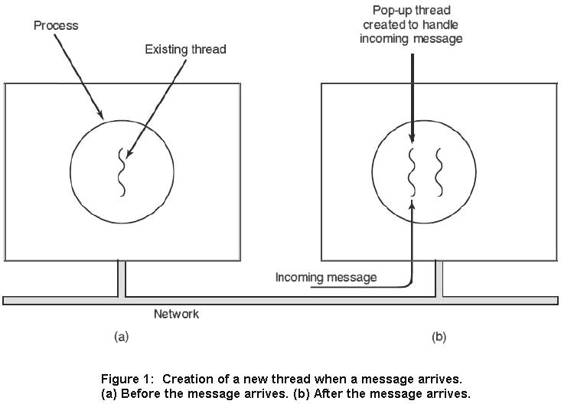

Slide 114
2.3 INTERPROCESS COMMUNICATION
Processes frequently need to communicate with other processes.
For example, in a shell pipeline, the output of the first process must be passed to the second process.
Thus there is a need for communication between processes.
There are three issues here:

Slide 115
The first how one process can pass information to another.
The second has to do with making sure two or more processes do not get in each other’s way, for example, two processes in an airline reservation system each trying to grab the last seat on a plane for a different customer.
The third concerns proper sequencing when dependencies are present: if process A produces data and process B prints them, B has to wait until A has produced some data before starting to print.

Slide 116
2.3.1 Race Conditions
In some operating systems, processes that are working together may share some common storage that each one can read and write.
consider a simple but common example: a print spooler.
When a process wants to print a file, it enters the file name in a special spooler directory.
Another process, the printer daemon, periodically checks to see if there are any files to be printed, and if there are, it prints them and then removes their names from the directory.
Imagine that our spooler directory has a very large number of slots, numbered 0, 1, 2, ..., each one capable of holding a file name.
Also imagine that there are two shared variables, out, which points to the next file to be printed, and in, which points to the next free slot in the directory.

Slide 117
At a certain instant, slots 0 to 3 are empty (the files have already been printed) and slots 4 to 6 are full (with the names of files queued for printing).
Simultaneously, processes A and B decide they want to queue a file for printing. This situation is shown in Fig. 2-21.
Process A reads in and stores the value, 7, in a local variable called next free slot.
Just then a clock interrupt occurs and the CPU decides that process A has run long enough, so it switches to process B.
Process B also reads in and also gets a 7.
It, too, stores it in its local variable next free slot.
At this instant both processes think that the next available slot is 7.
Process B now continues to run. It stores the name of its file in slot 7 and updates in to be an 8. Then it goes off and does other things.

Slide 119
Eventually, process A runs again, starting from the place it left off.
It looks at next free slot, finds a 7 there, and writes its file name in slot 7, erasing the name that process B just put there.
Then it computes next free slot + 1, which is 8, and sets in to 8.
The spooler directory is now internally consistent, so the printer daemon will not notice anything wrong, but process B will never receive any output.
Situations like this, where two or more processes are reading or writing some shared data and the final result depends on who runs precisely when, are called race conditions.

